Slide 1
Numerical Computation
Darrell Long
CSE 13S
Joseph-Louis Lagrange

Slide 2
Basic Arithmetic Operations
Computers can only do basic operations such as addition, subtraction, multiplication and division.
Multiplication is shift and addition,
Division is shift and subtraction,
Addition is little more than exclusive-xor
What about trigonometric functions?
Some processors do them internally, but they are still using the basic operations.
What about integrals? What about transforms? What about …?
These are in the realm of numerical methods.

Slide 3
Absolute Value
That’s an easy one: abs(x) = if x < 0 then –x else x
Should I just write the code?
It depends… Most mathematical libraries have families of absolute value functions that depend on the data type.
It may be faster to let the compiler or the mathematics library do it, since as in the case of floating point it may be just clearing a bit.

Slide 4
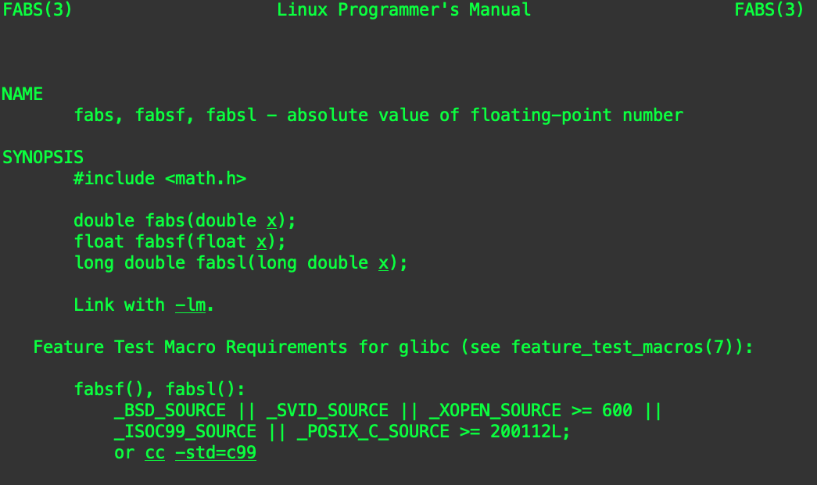
Check the man page!

Slide 5
Can I just use the library?
In general, yes, it is best to use the library.
The library should be designed to be:
Careful with numerical precision,
Fast, and portable.
That being said, it is important for you to have some understanding of what goes into implementing mathematical functions.
Remember: There is no magic!

Slide 6
Trigonometric Functions

Slide 7

Taylor Series
If $f(x)$ is a real or complex valued function, and it is infinitely differentiable then:
$f\left(x\right)=\sum_{n=0}^{∞}{\frac{f^{\left(n\right)}\left(a\right)}{n!} {(x−a)}^{n}}$
For example, consider $e^{x}$ centered at $a=0:$
$e^{x}=1+\frac{x}{1!}+\frac{x^{2}}{2!}+\frac{x^{3}}{3!}+…, −∞<x<∞$
Brook Taylor

Slide 8
Increasingly Better Approximations
Each derivative adds a term to the approximating polynomial.

Slide 9
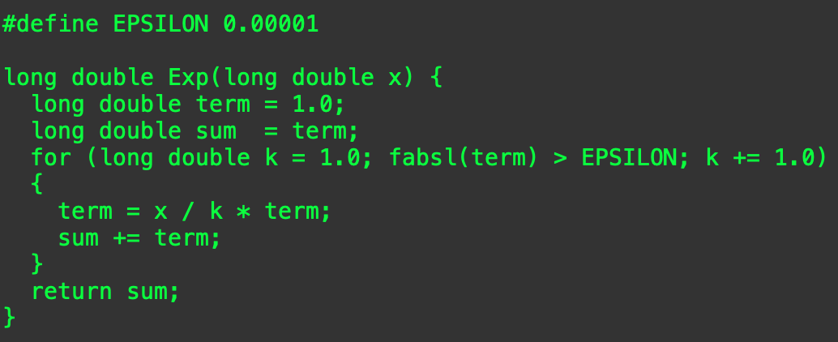


Computing $e^{x}$
$k!> x^{k}$ for all $x$, eventually (when $k$ gets large enough), so:
$\frac{x^{k}}{k!}$ gets smaller with each step (again, eventually)
We can stop when it gets small enough that it is “good enough” for our computation.

Slide 10


Computing $sin⁡(x)$
What do we know about $sin⁡(x)$?
It is:
Periodic on $[−2π, 2π]$, meaning that $\sin\left(9π\right)=\sin\left(π\right)$
Infinitely differentiable, making a good candidate for a Taylor series.
Where shall we center it? How about right in the middle, at zero:
$\sin\left(x\right)=x −\frac{x^{3}}{6}+\frac{x^{5}}{120}−\frac{x^{7}}{5040}+\frac{x^{9}}{362880}−\frac{x^{11}}{39916800}+O(x^{12})$
Is that good enough?
It depends on how close $x$ is to zero.
In general, you will need more terms.

Slide 11
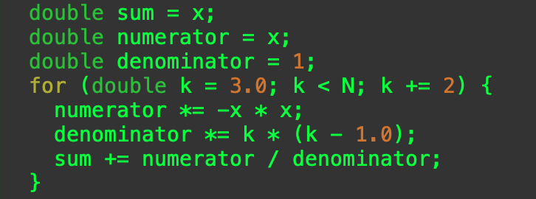

Computing the Terms
We skip even numbered terms, and
The sign of the terms alternate.
Before computing $sin⁡(x)$ do not forget to remove extra factors of $2π$.
How many terms do we need?

Slide 12
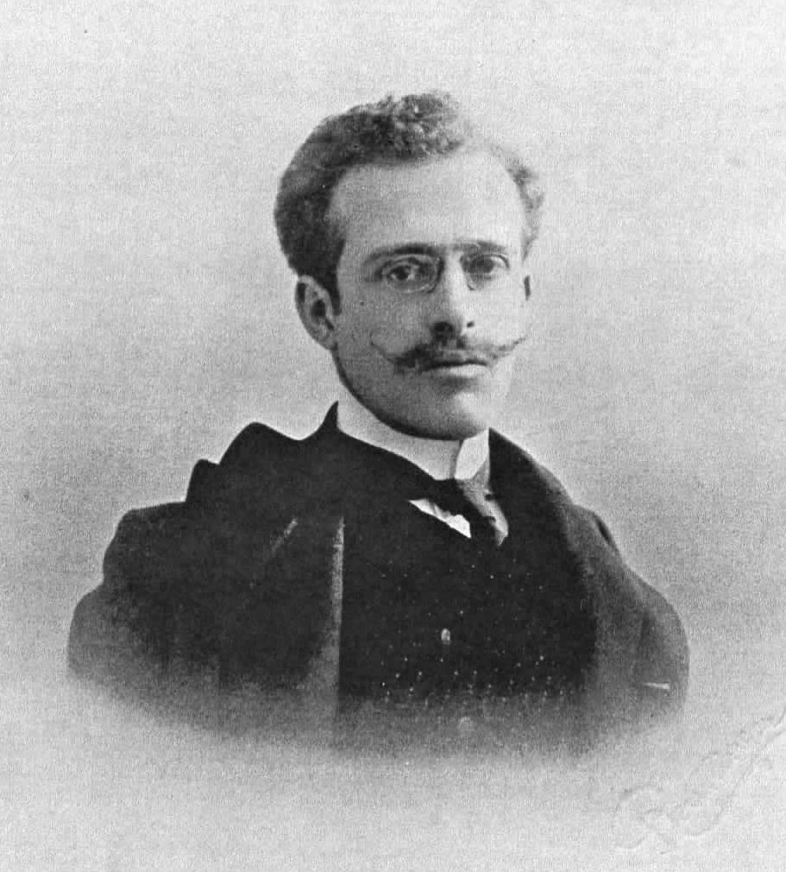
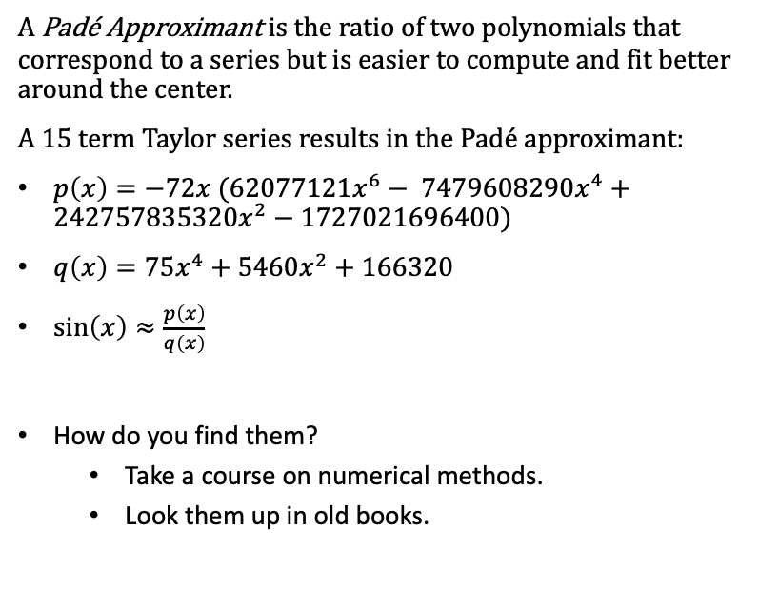
Padé Approximants
A Padé Approximant is the ratio of two polynomials that correspond to a series but is easier to compute and fit better around the center.
A $15$ term Taylor series results in the Padé approximant:
$p\left(x\right)=−72x (62077121x^{6}− 7479608290x^{4}+242757835320x^{2}−1727021696400)$
$q\left(x\right)=75x^{4}+5460x^{2}+166320$
$\sin\left(x\right)≈\frac{p\left(x\right)}{q\left(x\right)}$
How do you find them?
Take a course on numerical methods.
Look them up in old books.
Henri Padé

Slide 13
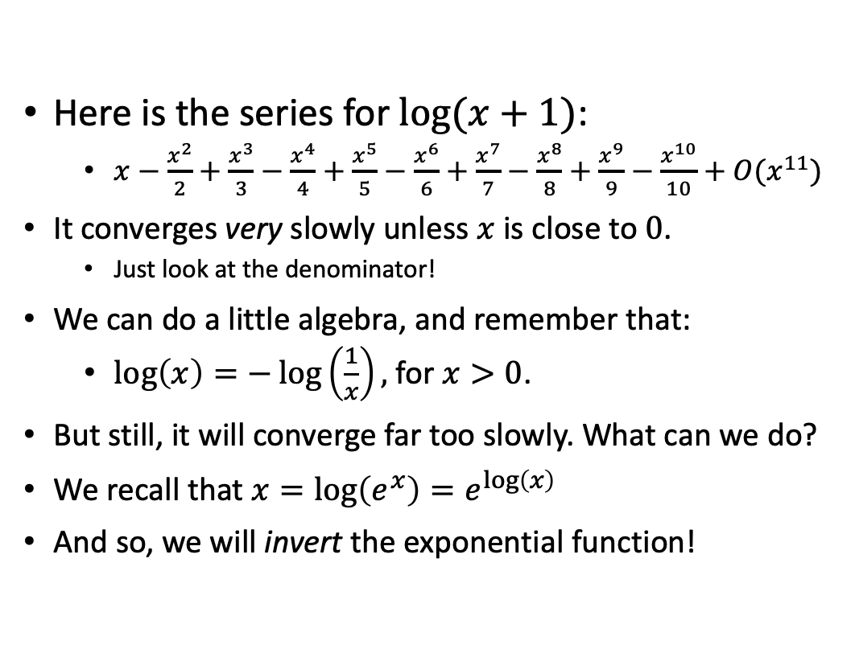
What happens if the series converges too slowly?
Here is the series for $log⁡(x+1)$:
$x−\frac{x^{2}}{2}+\frac{x^{3}}{3}−\frac{x^{4}}{4}+\frac{x^{5}}{5}−\frac{x^{6}}{6}+\frac{x^{7}}{7}−\frac{x^{8}}{8}+\frac{x^{9}}{9}−\frac{x^{10}}{10}+O(x^{11})$
It converges very slowly unless $x$ is close to $0$.
Just look at the denominator!
We can do a little algebra, and remember that:
$\log\left(x\right)=−\log\left(\frac{1}{x}\right),$for $x>0$.
But still, it will converge far too slowly. What can we do?
We recall that $x=\log\left(e^{x}\right)=e^{\log\left(x\right)}$
And so, we will invert the exponential function!

Slide 14
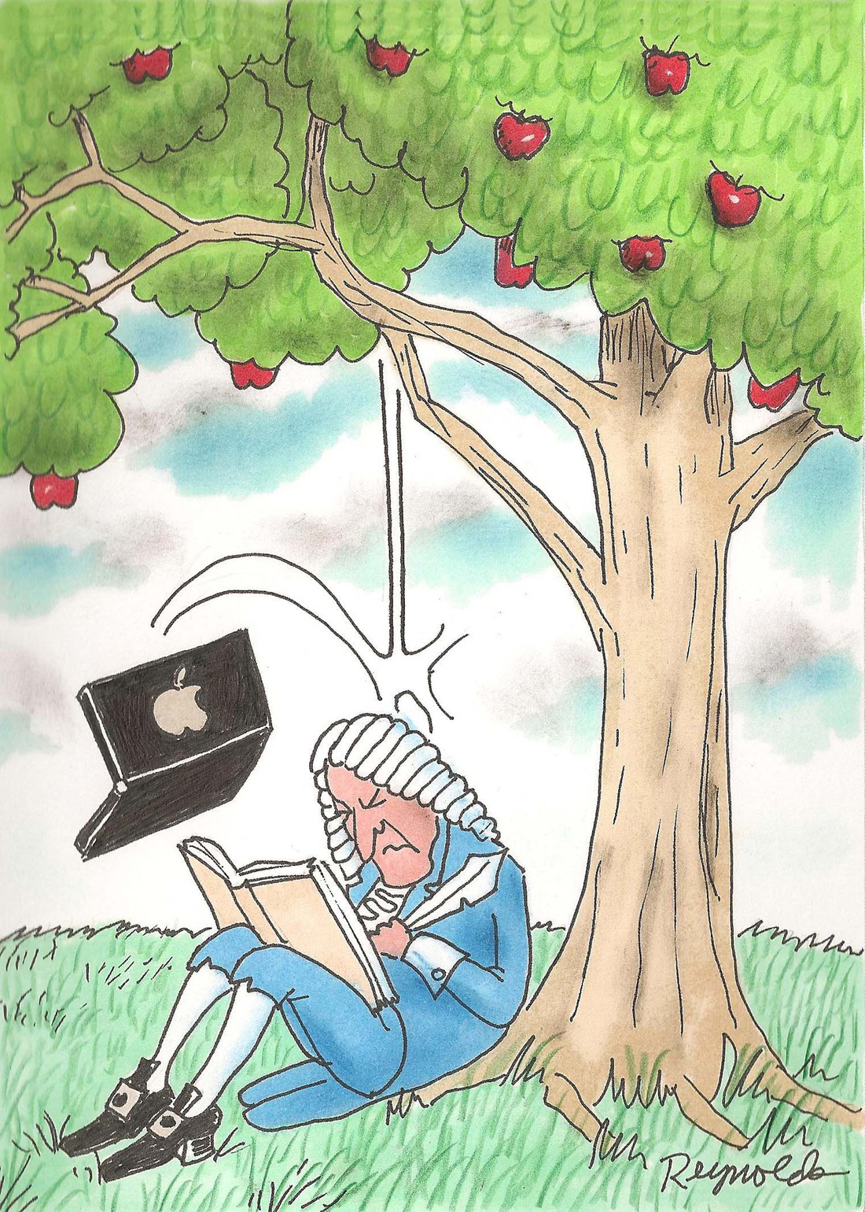
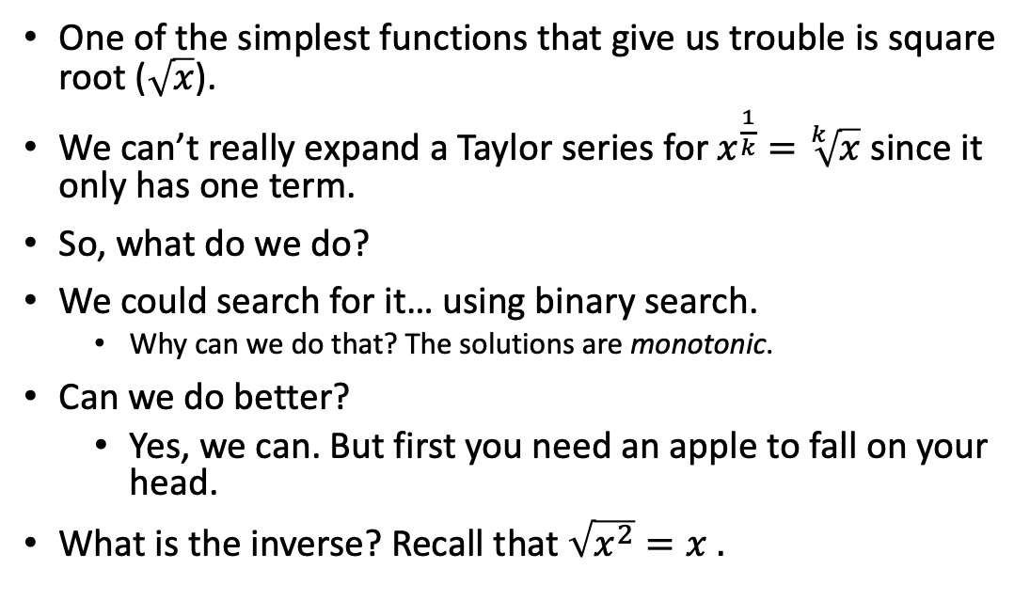
Inverting a Function
One of the simplest functions that give us trouble is square root ($\sqrt{x}$).
We can’t really expand a Taylor series for $x^{\frac{1}{k}}=\sqrt[k]{x}$ since it only has one term.
So, what do we do?
We could search for it… using binary search.
Why can we do that? The solutions are monotonic.
Can we do better?
Yes, we can. But first you need an apple to fall on your head.
What is the inverse? Recall that $\sqrt{x^{2}}=x .$

Slide 15
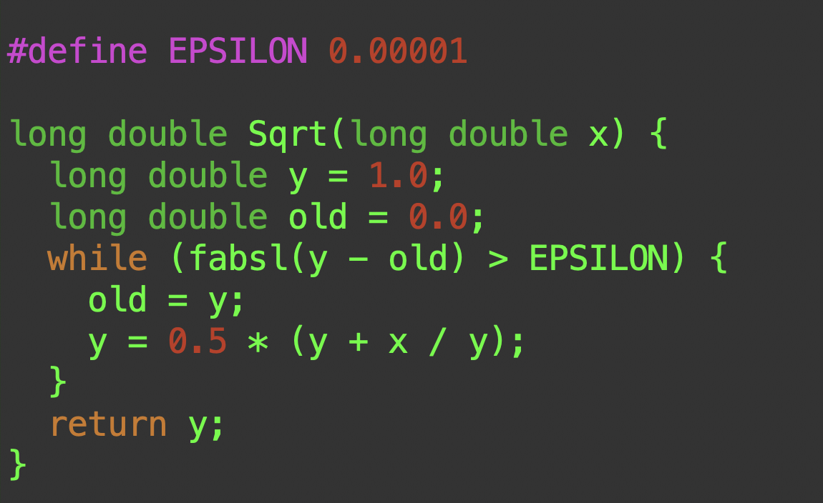
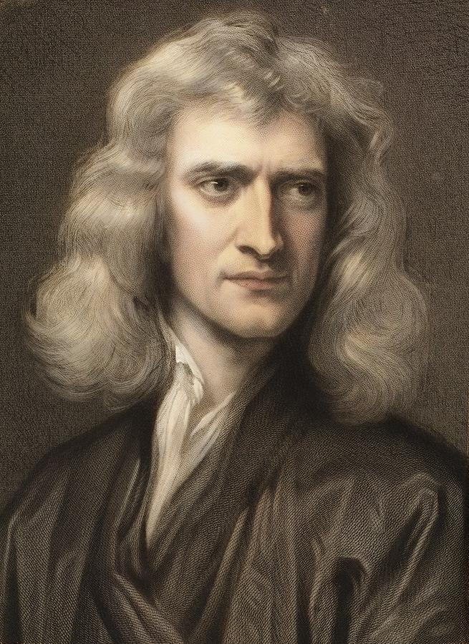


$\sqrt{n}$ using a Newton Iterate
Sir Isaac Newton comes to the rescue again.
We use this iterate:
$x_{k+1}=\frac{1}{2}(x_{k}+\frac{n}{x_{k}})$
As before, we iterate until the approximation is good enough.

Slide 16
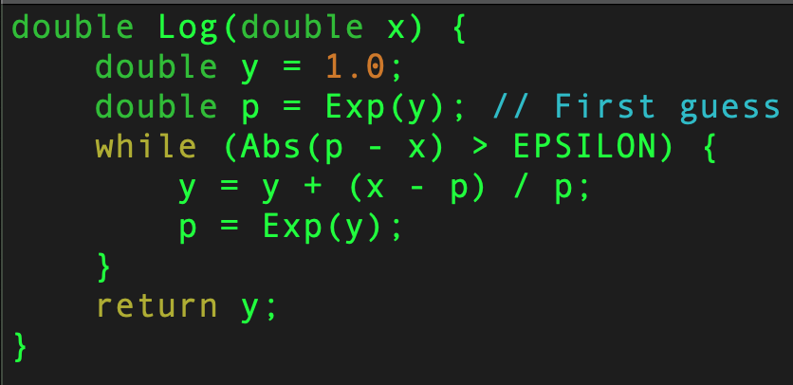


$log⁡(x)$ using Newton’s Method
Newton’s formula provides a linear approximation of the function.
Solve for $x_{n+1}$
$x_{n+1}=x_{n}+\frac{f\left(x_{n}\right)}{f^{′}\left(x_{n}\right)}$
Find the root of $f\left(y\right)=x −e^{y}$
We iterate this equation until our answer is close enough:
$y_{n+1}=y_{n}+\frac{x−e^{y_{n}}}{e^{y_{n}}}$
For details, ask your calculus professor!
You can get very deep very quickly!

Slide 17
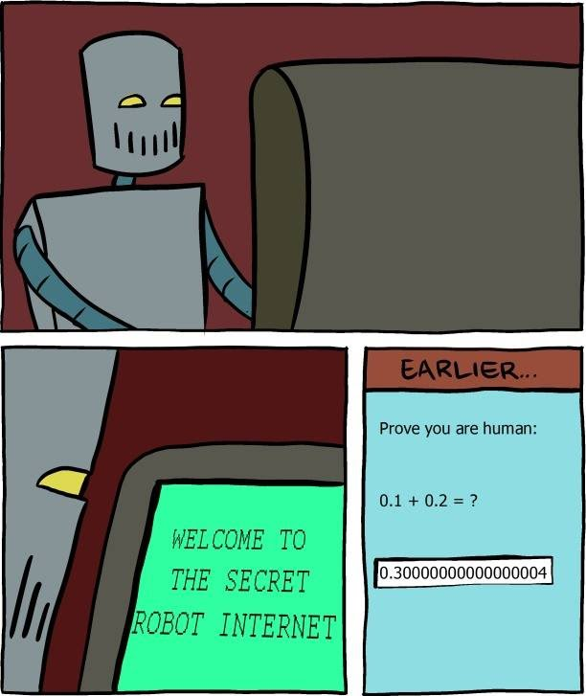
Floating Point Arithmetic
Normal mathematics:
Real numbers are exact
Computer arithmetic:
numbers are approximated (finite)
Approximations cause round-off errors. Why?
Because the result is also an approximation!

Slide 18
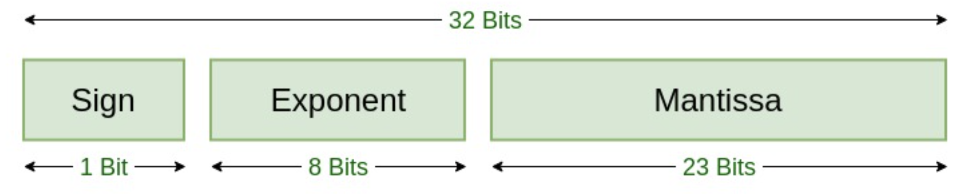
IEEE 754 Floating Point Standard
The floating point standard is used to represent numbers in binary
Single precision: 32 bit
Sign bit (s) - indicates sign
Characteristic (c) - 8 bit base-2 exponent with a range of -126 to 127
Mantissa (f) - 23 bit binary fraction which amounts to 6 digit decimal precision
Double precision: 64 bit
1 bit sign, 11 bit characteristic and 52 bit mantissa
Notes:
SIngle precision:
For the characteristic 8 bits represent numbers in the range 0 to (2⁸ -1) = 255. Accommodating negative numbers, the range is -126 to +127.
The mantissa has 23 bits which is 6 digits after the decimal point.
Double precision:
For the characteristic 11 bits represent numbers in the range 0 to (2¹¹ -1) = 2047. Accommodating negative numbers, the range is -1023 to +1024.
The mantissa has 52 bits which is 16 digits after the decimal point

Slide 19
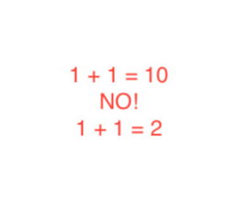
Decimal Representation
Decimal representation is easier for us to understand conceptually
Float point form is obtained by chopping or rounding the mantissa.
For ex. π = 3.14159265,
On five-digit chopping:
π = 3.1415
On five-digit rounding:
π = 3.1416
Notes:
Floating point form from decimal representation is obtained by terminating the mantissa. This can be done in two ways, chopping and rounding.
In the example, when pi is five digit chopped, it’s value is 3.1415. But when it is being five digit rounded, the digit after 5 is taken into consideration. Since it is 9, the decimal is rounded up and pi is 3.1416.

Slide 20

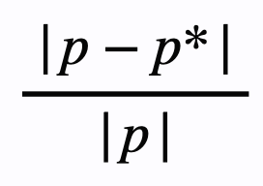
Absolute error and relative error
If p* is an approximation of p, absolute error is given by:
Relative error is given by:
Notes:
This slide has the formulae for absolute and relative error calculation. p* is the approximation, i.e. the number after chopping or rounding. p is the exact value which has been approximated into p*.

Slide 21
Relative error
is more meaningful
Because it takes the size of the value into consideration.
For ex., p = 3.0, p* = 3.1
Absolute error = 0.1
Relative error = 0.03333
p = 0.003, p* = 0.0031
Absolute error = 0.0001
Relative error = 0.03333
Notes:
Absolute error gives the actual difference between the approx. and exact values. Relative error indicates how big the loss in accuracy is w.r.t the scale of the number. Here, in the second half of the example, although the abs. error looks very small, the relative error shows that its a big error for numbers of that scale.

Slide 22
Finite Digit Arithmetic
For ex.,
If we were subtracting two nearly equal numbers, there is a large loss in the number of significant digits
p = 0.54617, q = 0.54601
Exact: p - q = 0.00016
Chopping approximation (4 digits):
p* - q* = 0.5461 - 0.5460 = 0.0001
Rounding approximation (4 digits):
p* - q* = 0.5462 - 0.5460 = 0.0002
Calculation in actuality uses a lot of logical and shifting operations as opposed to math operations.
After every calculation the result is once again approximated to fit it into a finite number of digits.
This results in a loss of accuracy as the number of calculations increases.
Notes:
In the example, p and q have 5 significant digits. On exact calculation, there is a reduction in significant digits in the result to 2. But on approximating, the reduction goes down further to 1 significant digit. Relative error is 0.25 for chopping and 0.375 for rounding

Slide 23
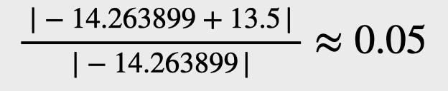
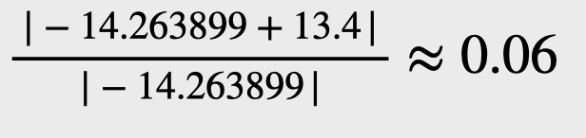
Nested Arithmetic
Loss of accuracy can be mitigated by re-arranging calculations
For ex.,
Let’s evaluate
f(x) = x³ - 6.1x² + 3.2x + 1.5 at x = 4.71
Relative error on chopping :
Method | Value
Exact | -14.263899
Chopping | -13.5
Rounding | -13.4
Relative error on rounding :
Notes:
Accuracy is lost as we peform more and more arithmetic calculation. Nesting reduces the overall number of calculations and that reduces the error.

Slide 24
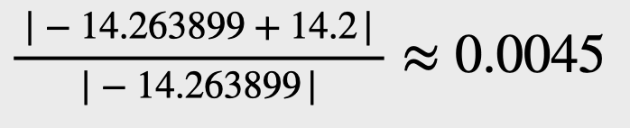
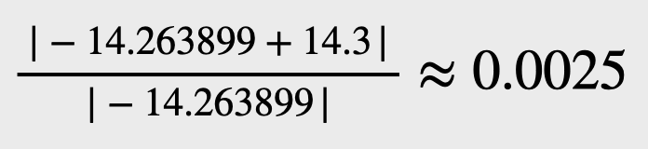
On nesting the calculation:
f(x) = ((x-6.1)x + 3.2)x + 1.5
Relative error on chopping :
Method | Value
Exact | -14.263899
Chopping | -14.2
Rounding | -14.3
Relative error on rounding :
Notes:
The relative error is much smaller after nesting the calculation. The number of arithmetic calculations have been reduced from four multiplications and three additions to two multiplications and three additions.

Slide 25

What do we know?
Floating point numbers are not real numbers.
We need to take care when working with floating point numbers due to limited precision.
For example, subtracting two numbers of very different magnitudes can lose precision.
A Taylor series can approximate an infinitely differentiable function to arbitrary precision, but:
Often the series converges too slowly to be useful.

Slide 26

What should we do?
Use a good library when you can.
Be cognizant of the difference between floating point and real numbers.
Real numbers are all of the numbers, rational numbers are a subset of the reals, and floating point numbers are a subset of the rationals.
If you forget that they are different, you will get incorrect answers.
Understand that all of the special functions we have discussed are approximations.

